Slide 1
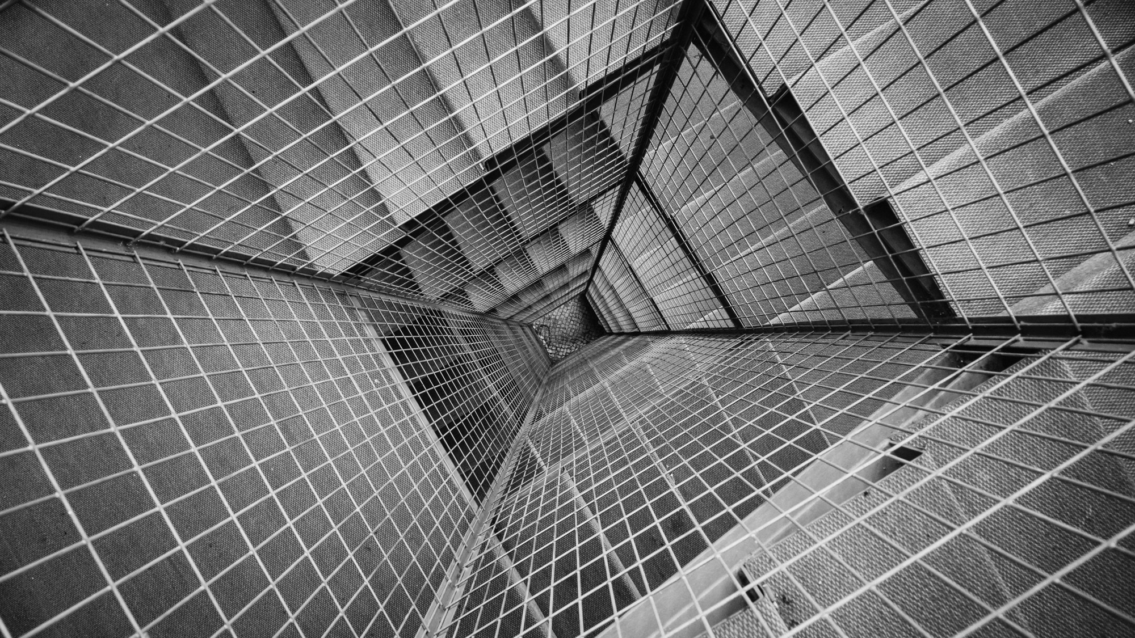
HIFBox
Help I’ve Fallen
Kemar Carnegie
Jeremy Sukhu
Rula Al-fadhli

Slide 2
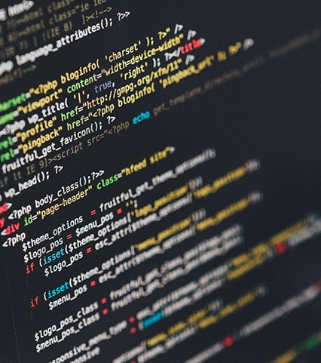
Content:
Proposal.
Design of the project.
Database.
Context Diagram.
Implementation hurdles.
Conclusion.

Slide 3
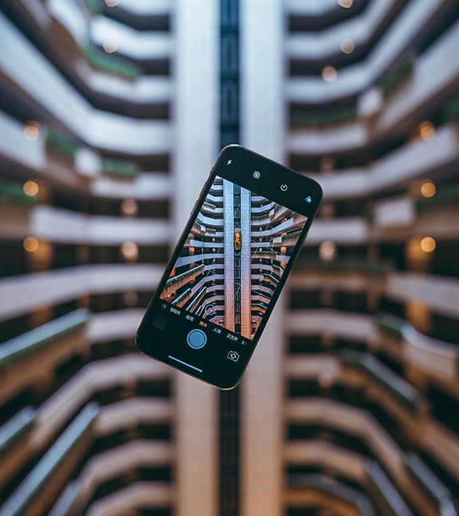
Proposal
Our proposal for this project will include the following:
The project we are planning to embark on, is one to create a wearable device that detect falls.
This device is for at-risk individual, to determine if they do or do not need assistance.
The app is targeted towards nurses or individuals in health care that takes care of the elderly.

Slide 4
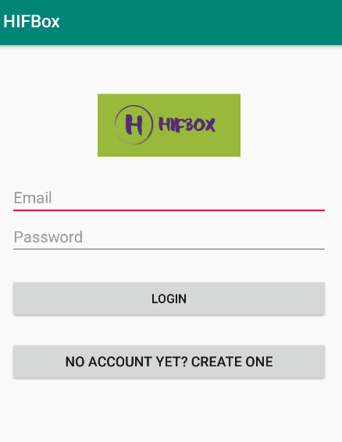
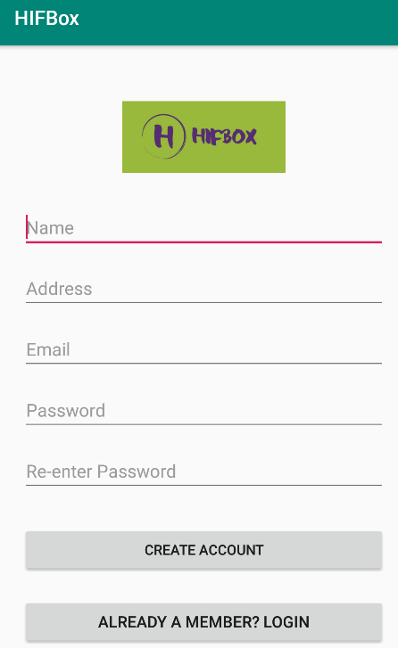
Design
Login and Registrations

Slide 5
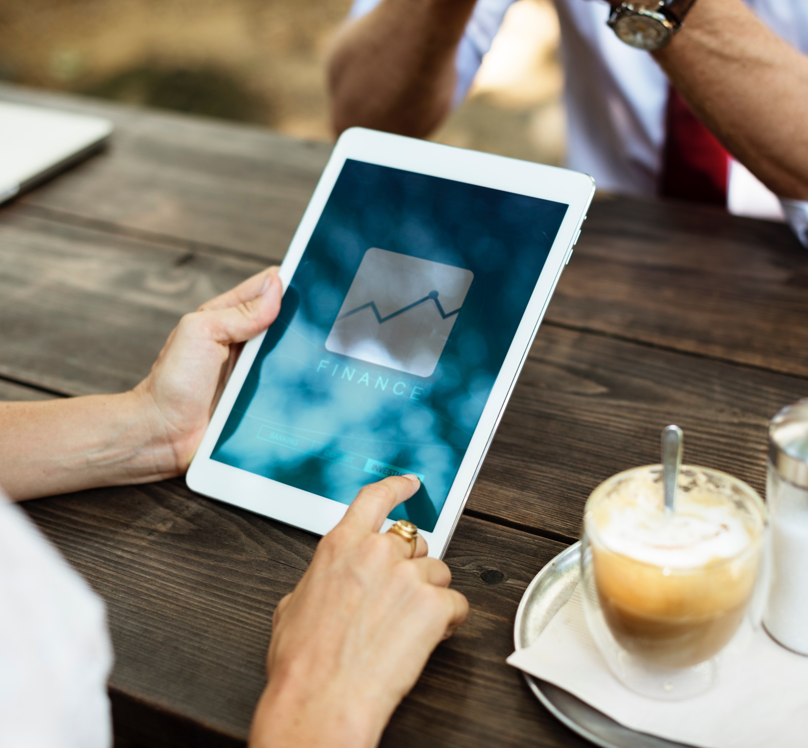
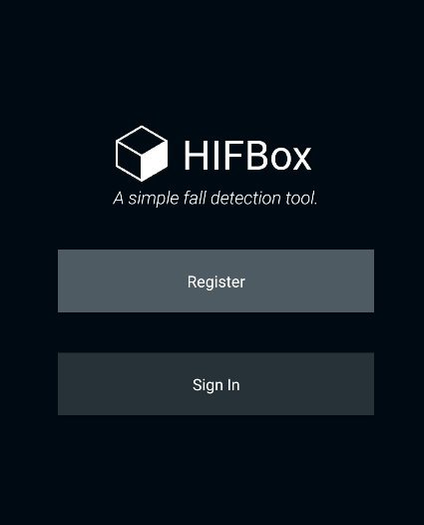
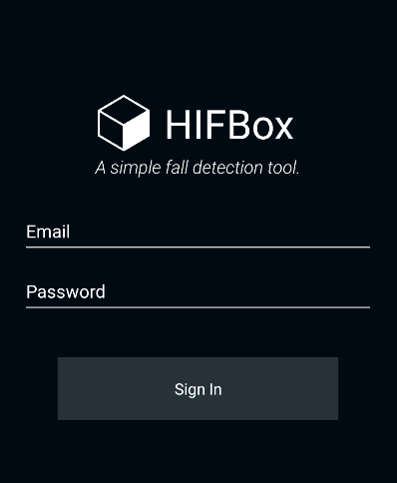
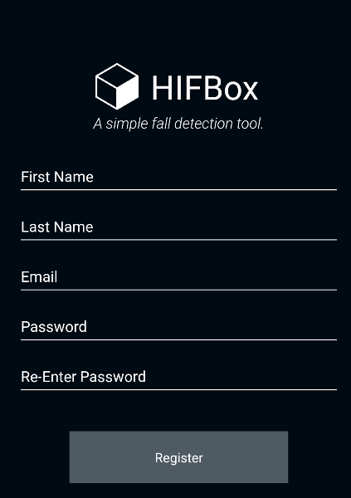
Final Design
Login and Registrations

Slide 6
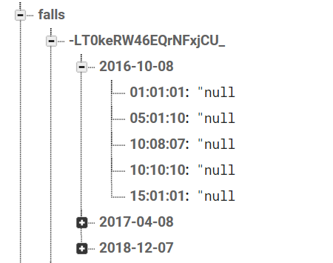
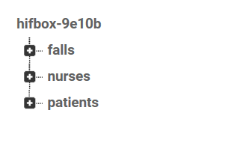
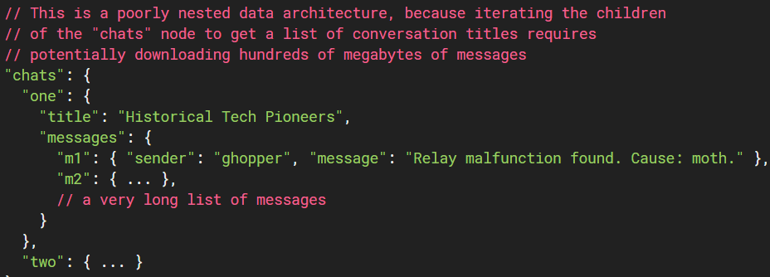
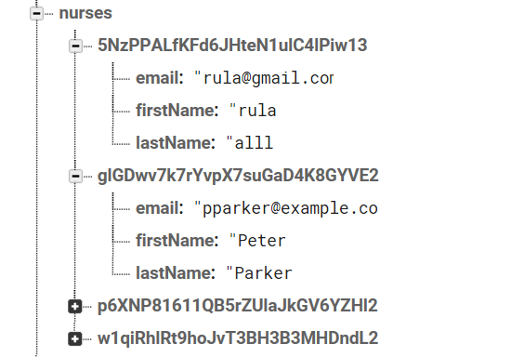
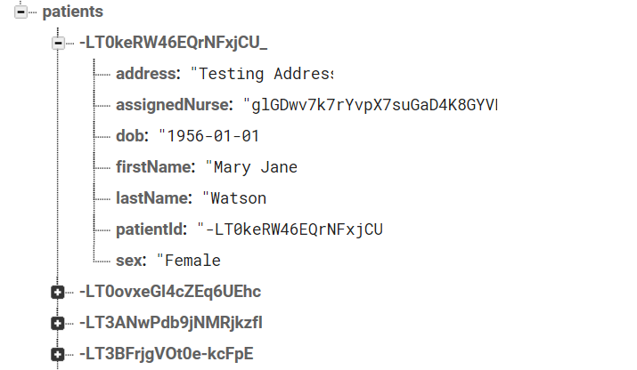
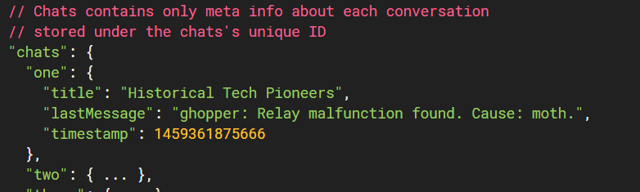
Firebase structure:
Avoid using nested data structures
Database :
Preferred to use Flatten data structures

Slide 7
Context Diagram
Login
Is valid?
Register
start
Main page
yes
View list of patient
yes
No
View patient info
No
View patient Graph

Slide 8
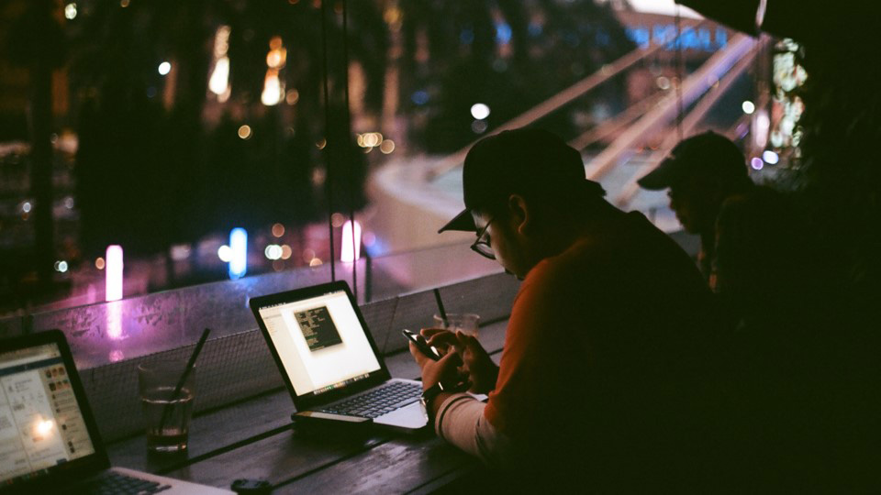
Large Picture Slide
Implementation hurdles
Graph.
Database structured.
Readings.
Notifications.
Demo…

Slide 9
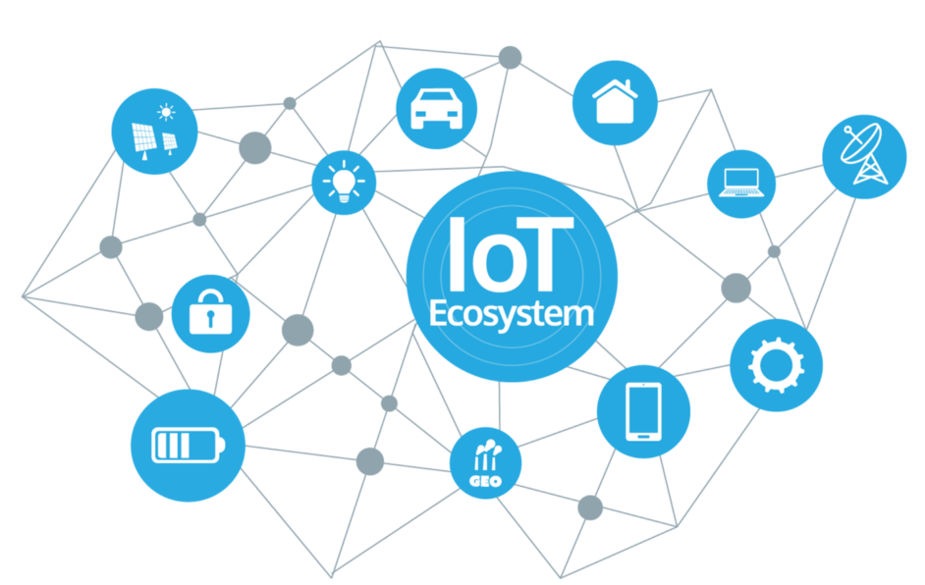
Conclusion
In conclusion, our goal is to utilize technology in the healthcare sector, by developing a digitalized device that would allow remote control and automatic monitoring of elderly people, using the required sensors that will make this task achievable.
For the future, and by the integration of cloud IoT, we are looking forward to expand this project to be more accessible and productive.

Slide 10
THANK YOU
https://github.com/4nmdk/hifboxclient

